Slide 1

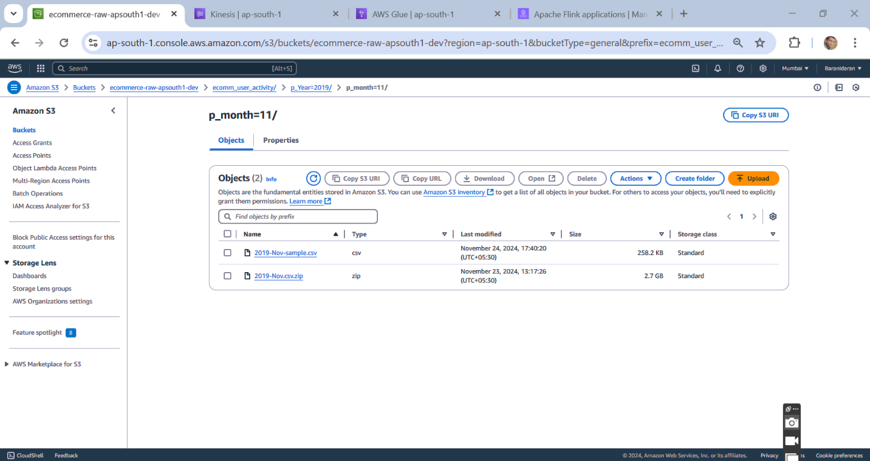
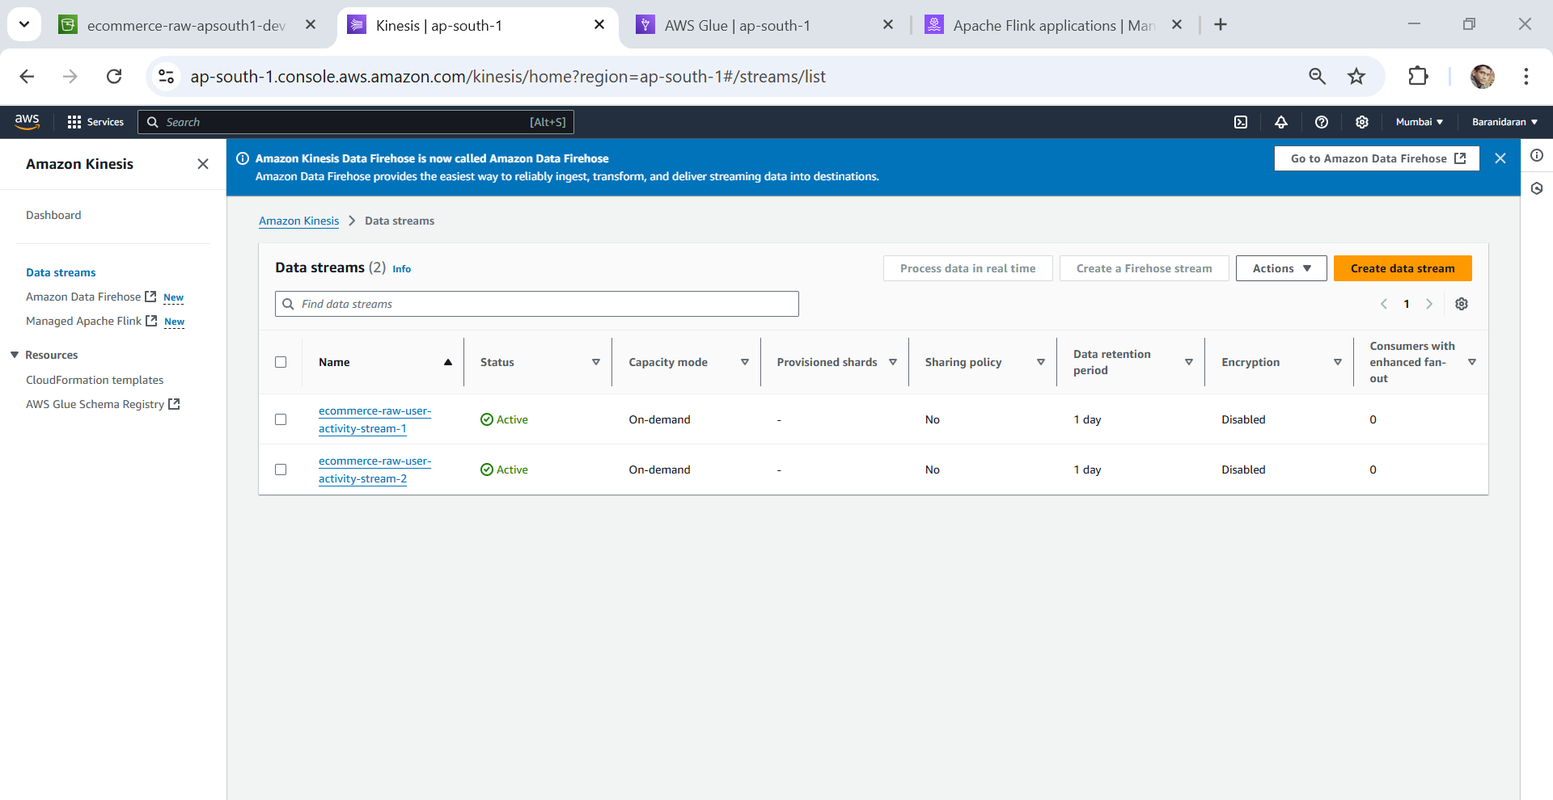
Mini Capstone Project – AWS Services
Creating s3 Bucket
Creating Data stream – aws Kinesis

Slide 2
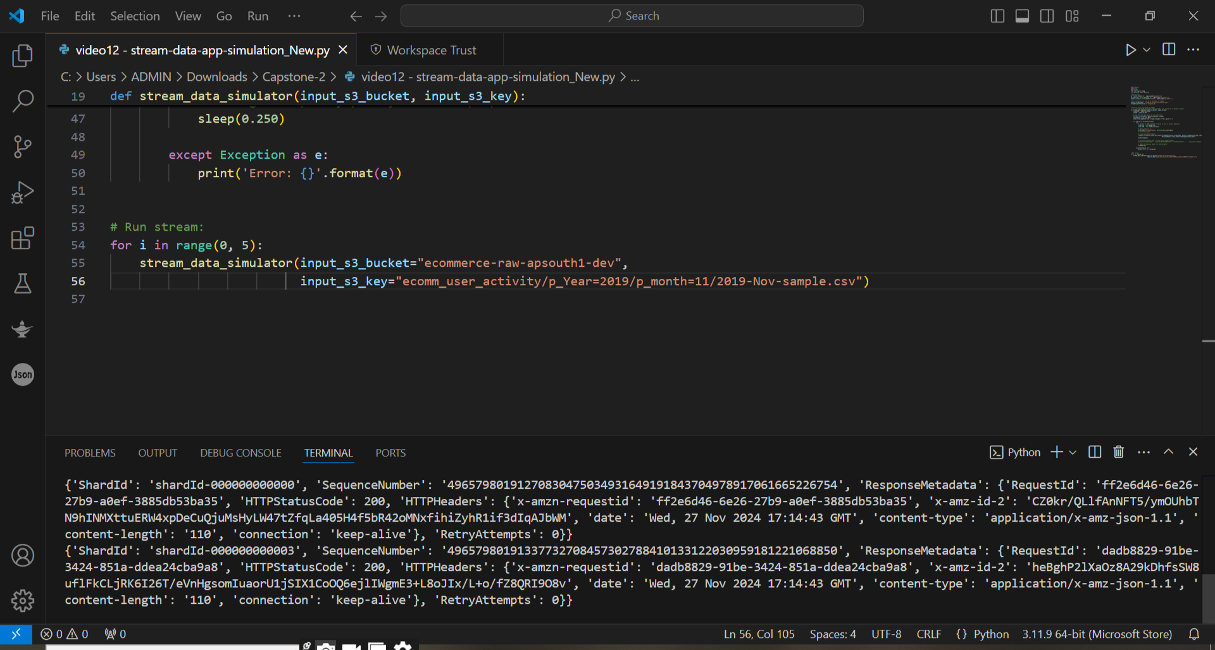
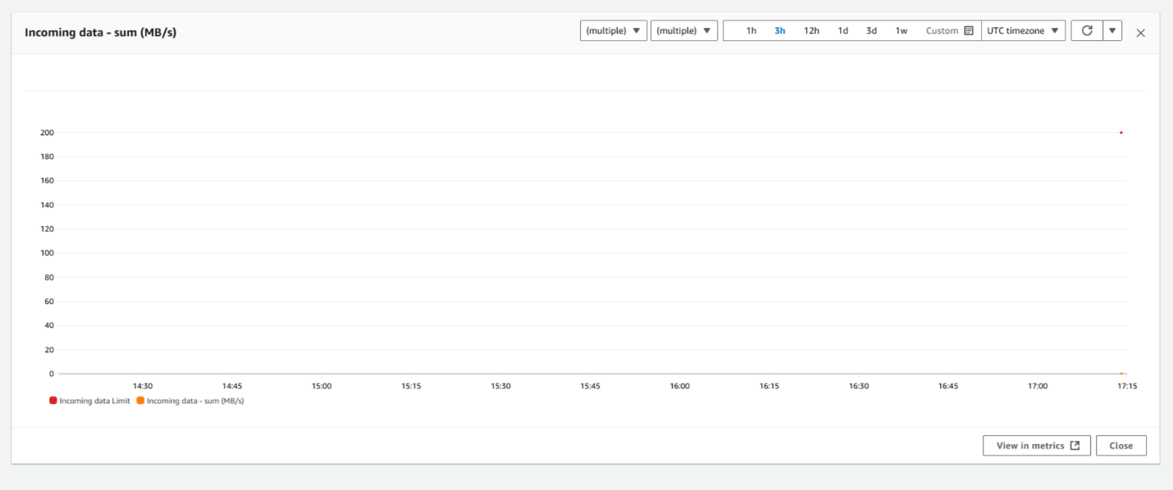
Mini Capstone Project – AWS Services
Running the code in VS code IDE
Realtime data running in – aws Kinesis

Slide 3
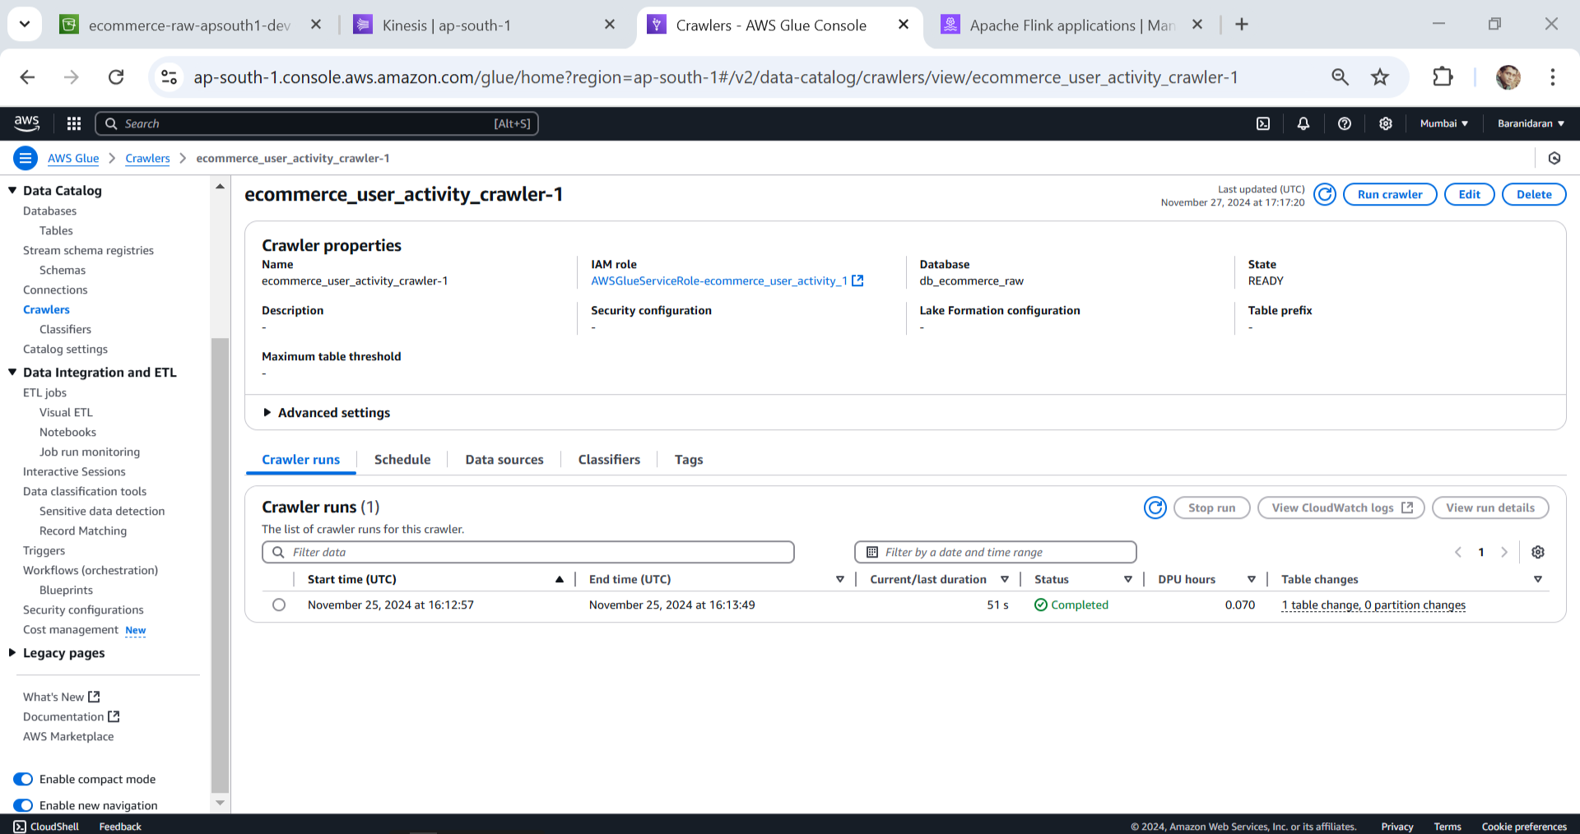
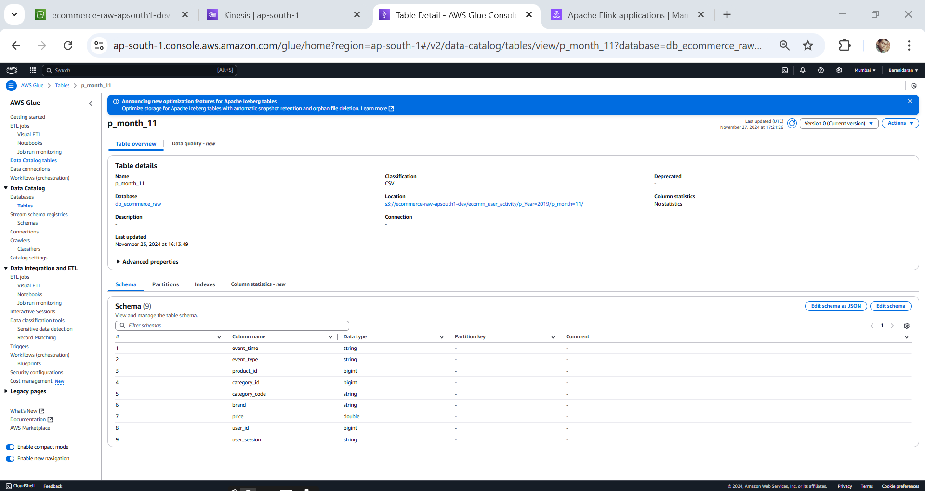
Mini Capstone Project – AWS Services
Create a crawler – AWS Glue
Create a Table – AWS Glue

Slide 4
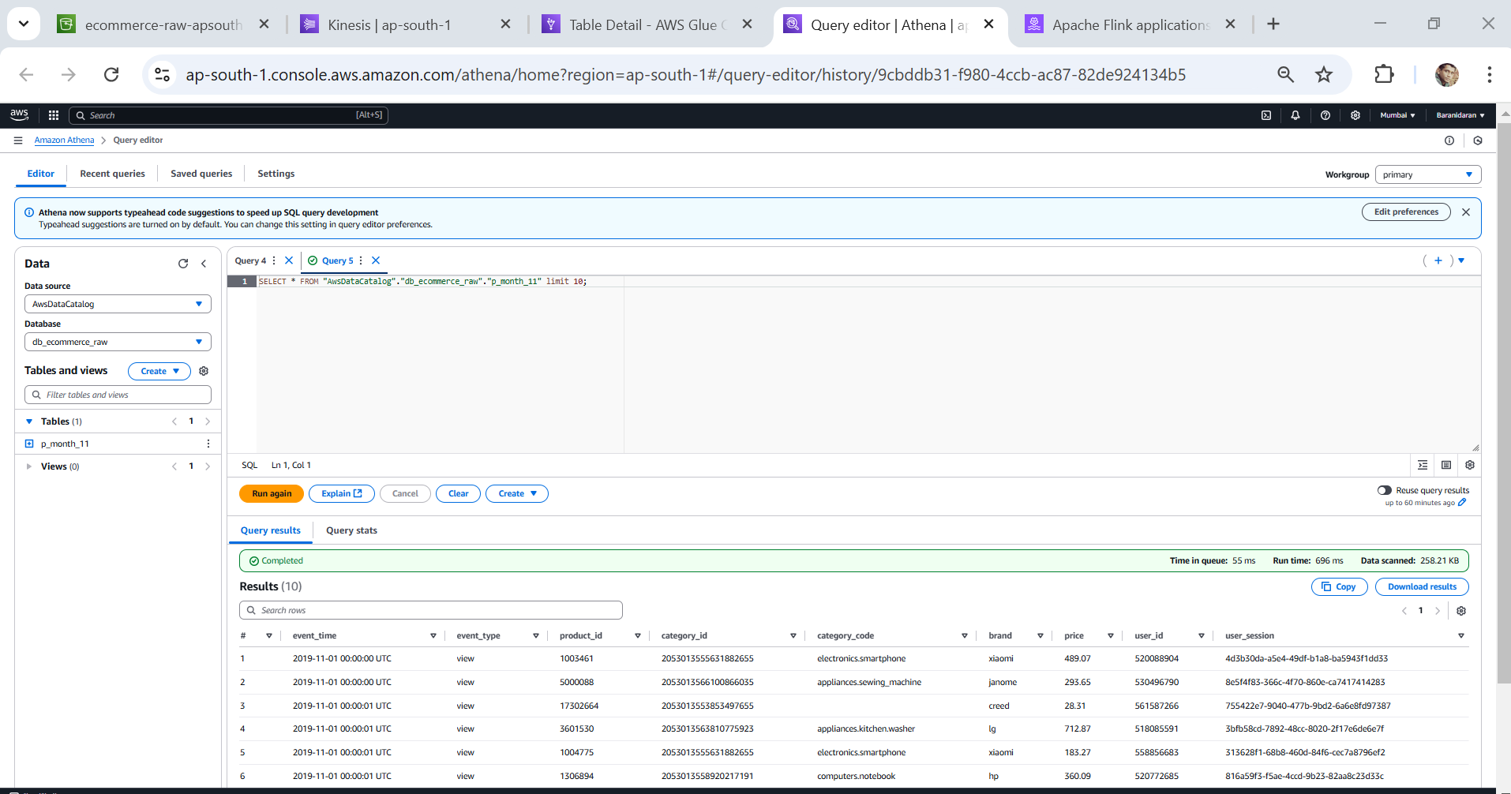
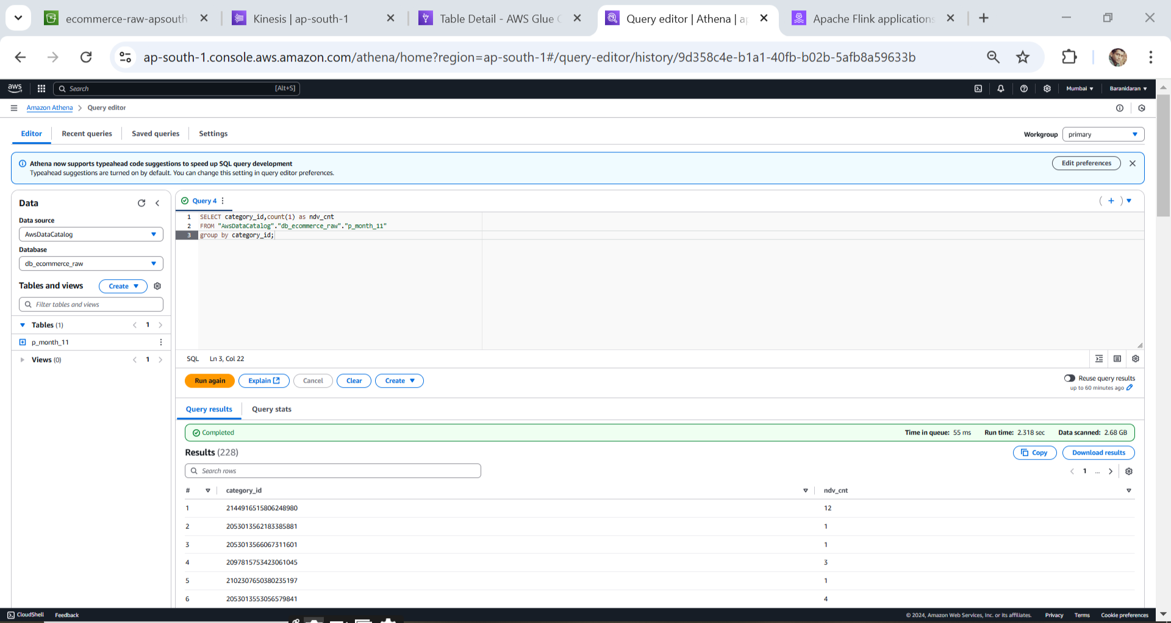
Mini Capstone Project – AWS Services
Running query in Athena –
Query - SELECT category_id,count(1) as ndv_cntFROM "AwsDataCatalog"."db_ecommerce_raw"."p_month_11"group by category_id;

Slide 5
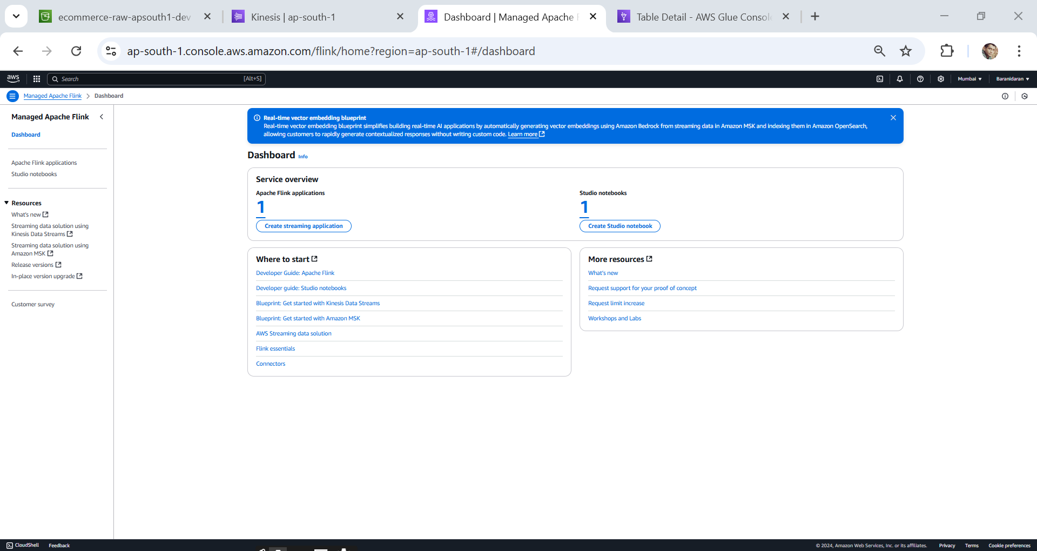
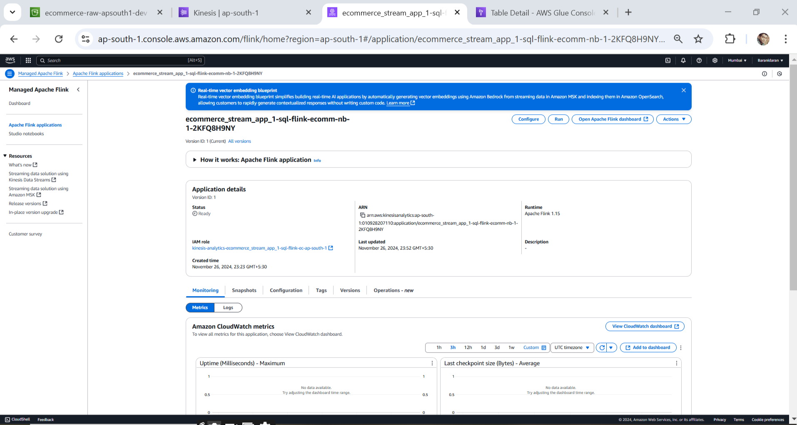
Mini Capstone Project – AWS Services
AWS Apache flink
Created Studio note book

Slide 6
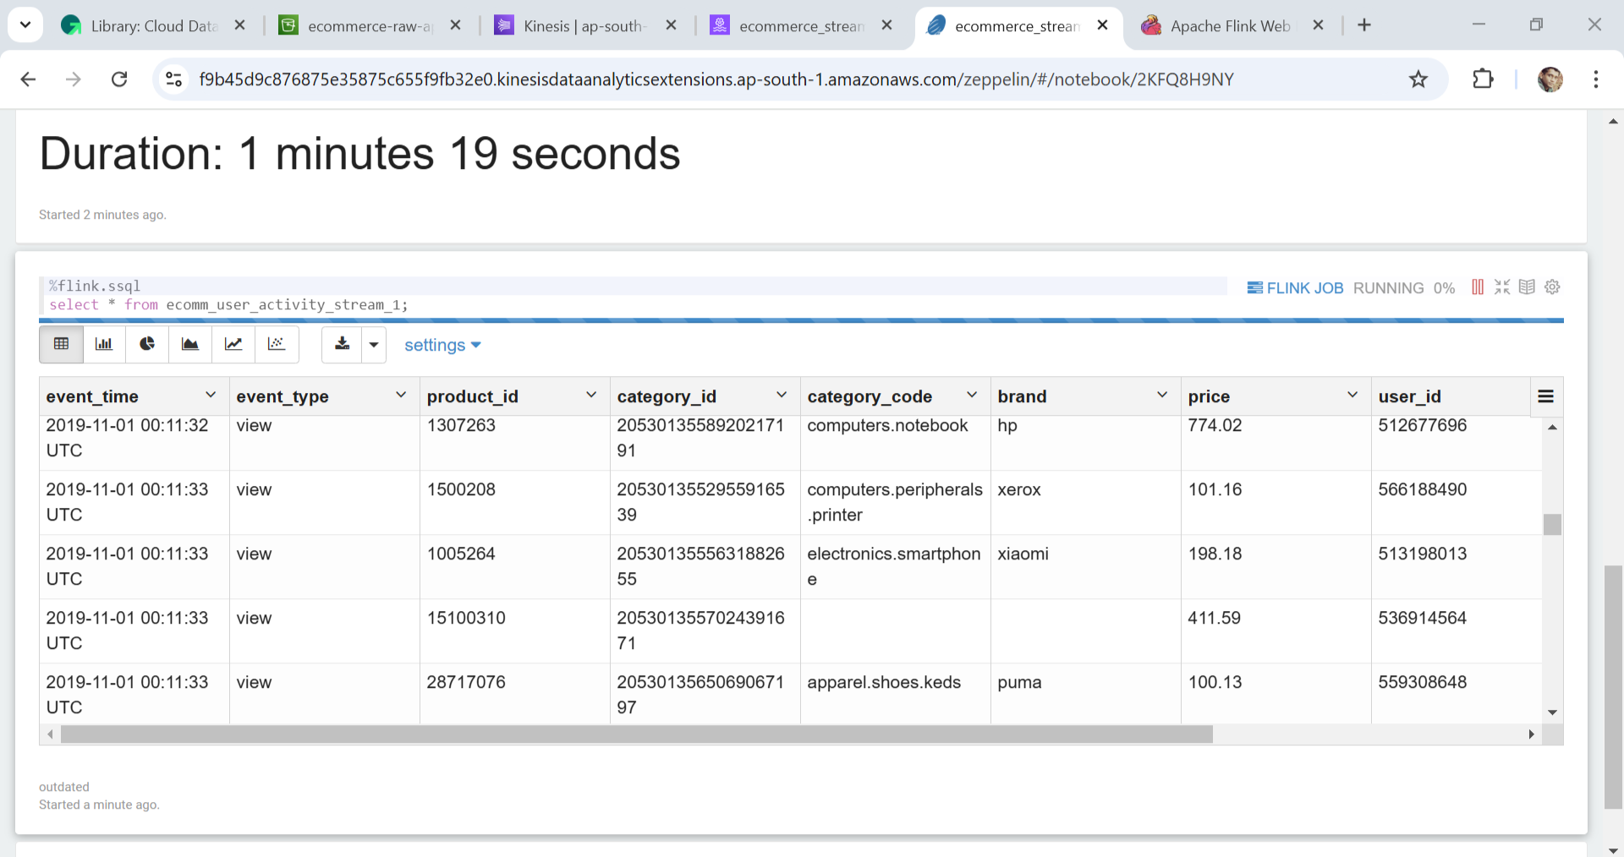
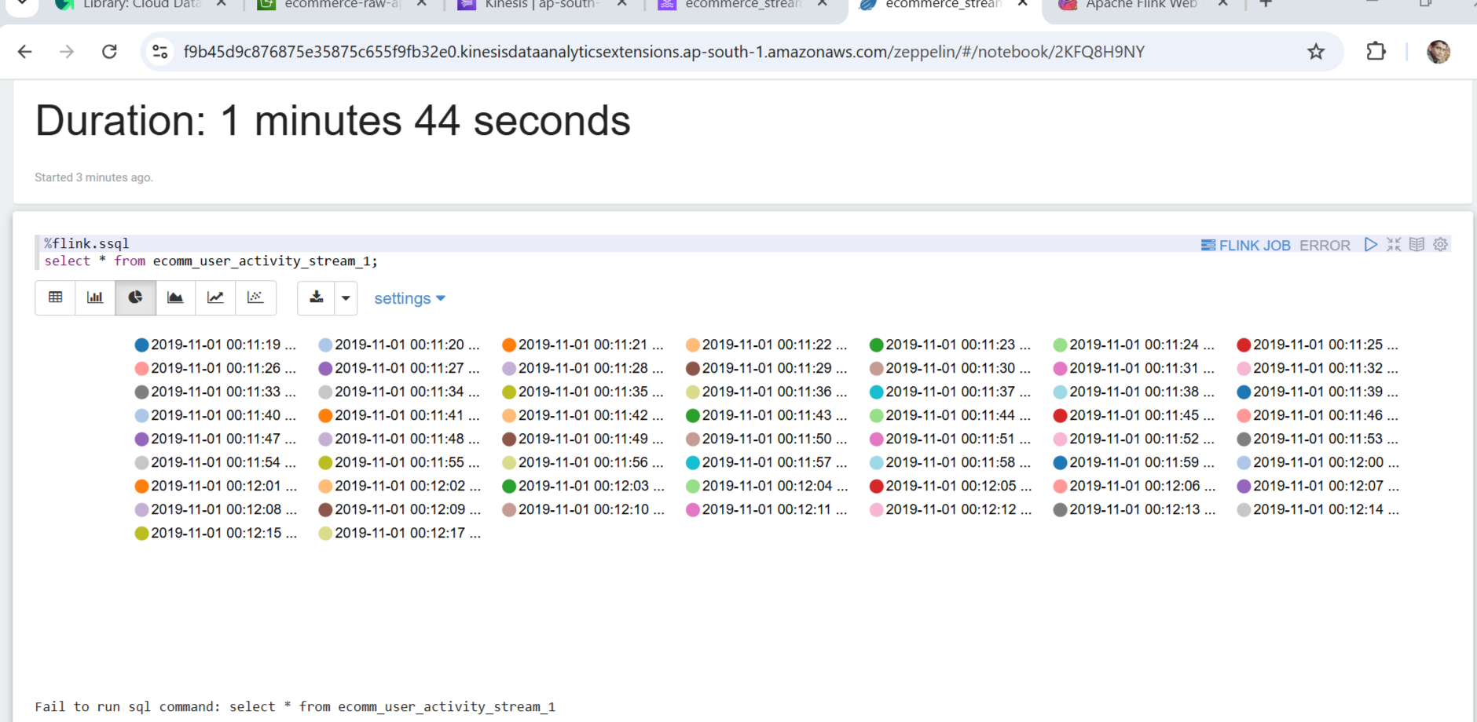
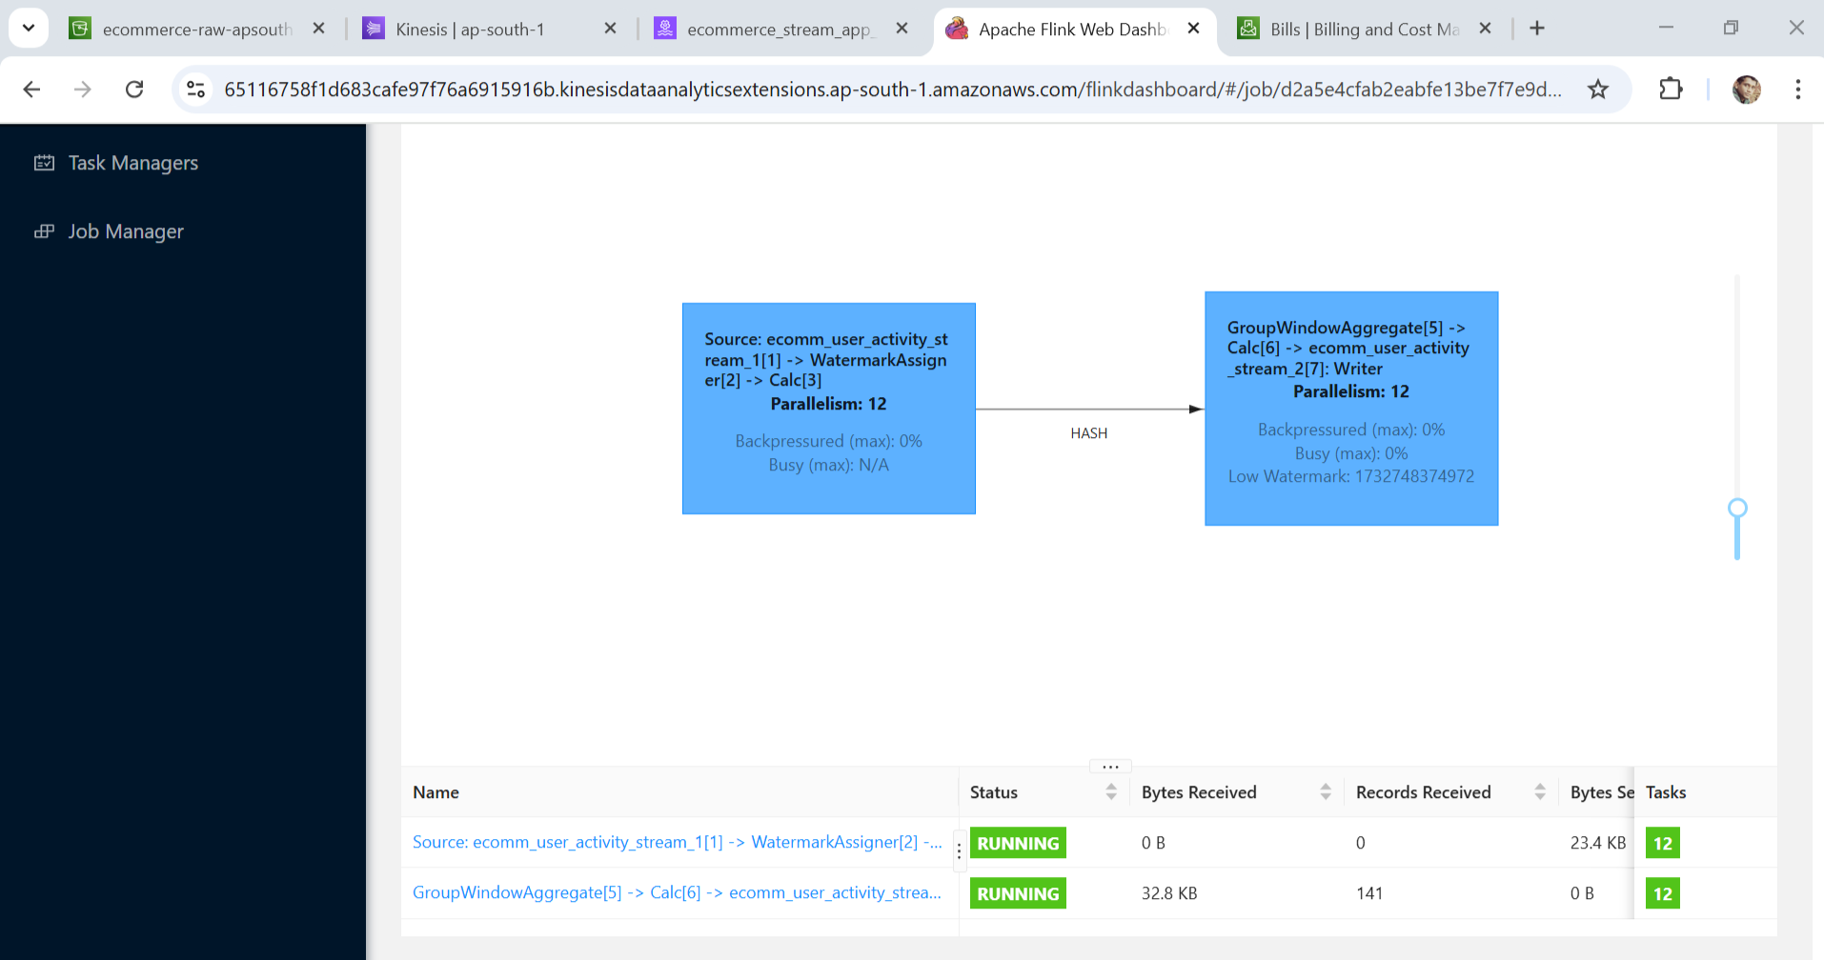
Mini Capstone Project – AWS Services
AWS Apache flink – Zebline Real time data

Slide 7
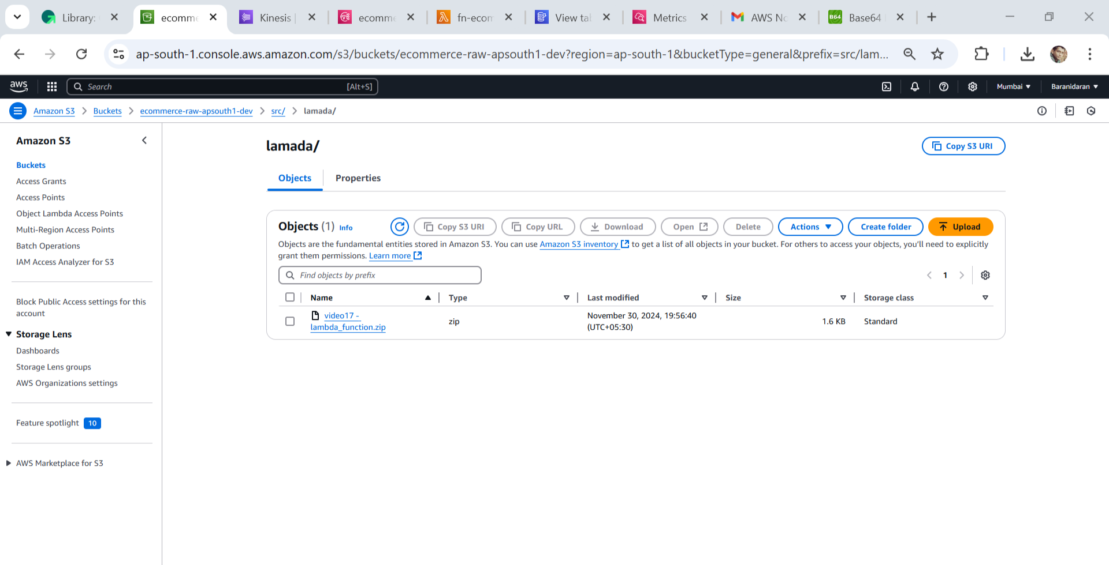
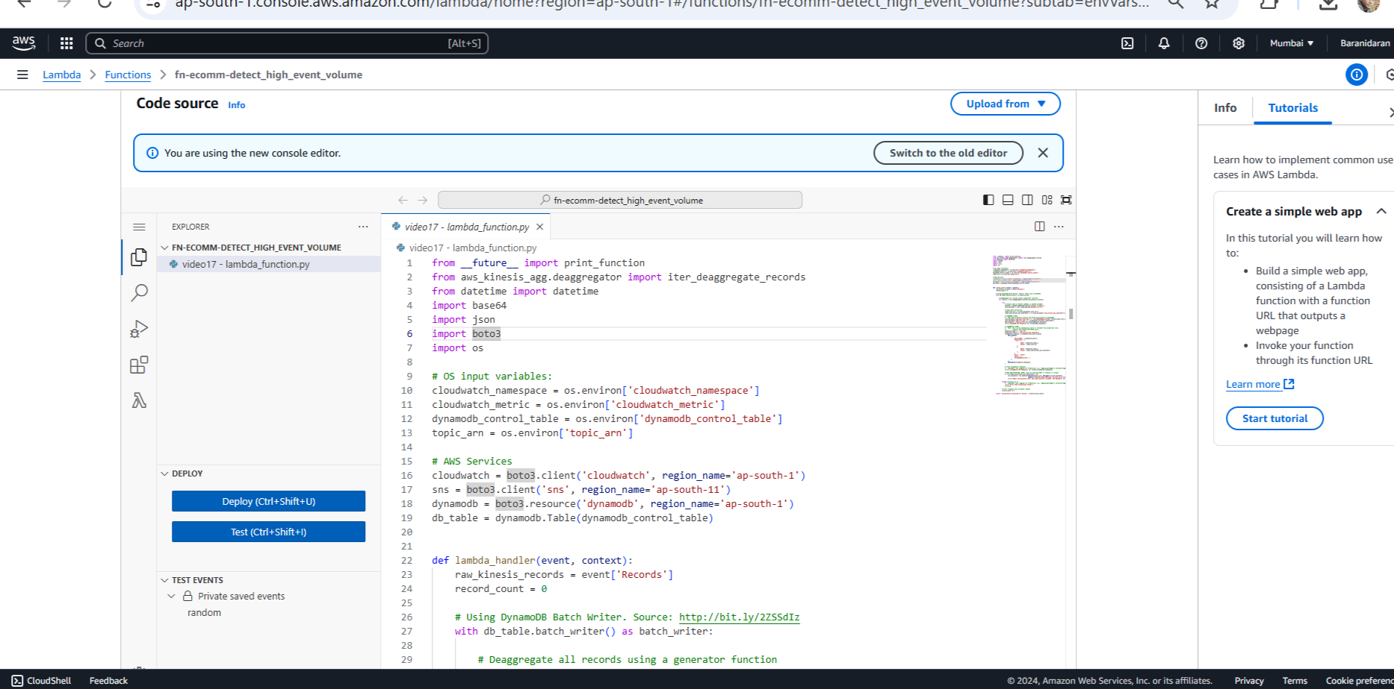
Mini Capstone Project – AWS Services
AWS Lamada function-S3 bucket
Power Lambda function

Slide 8
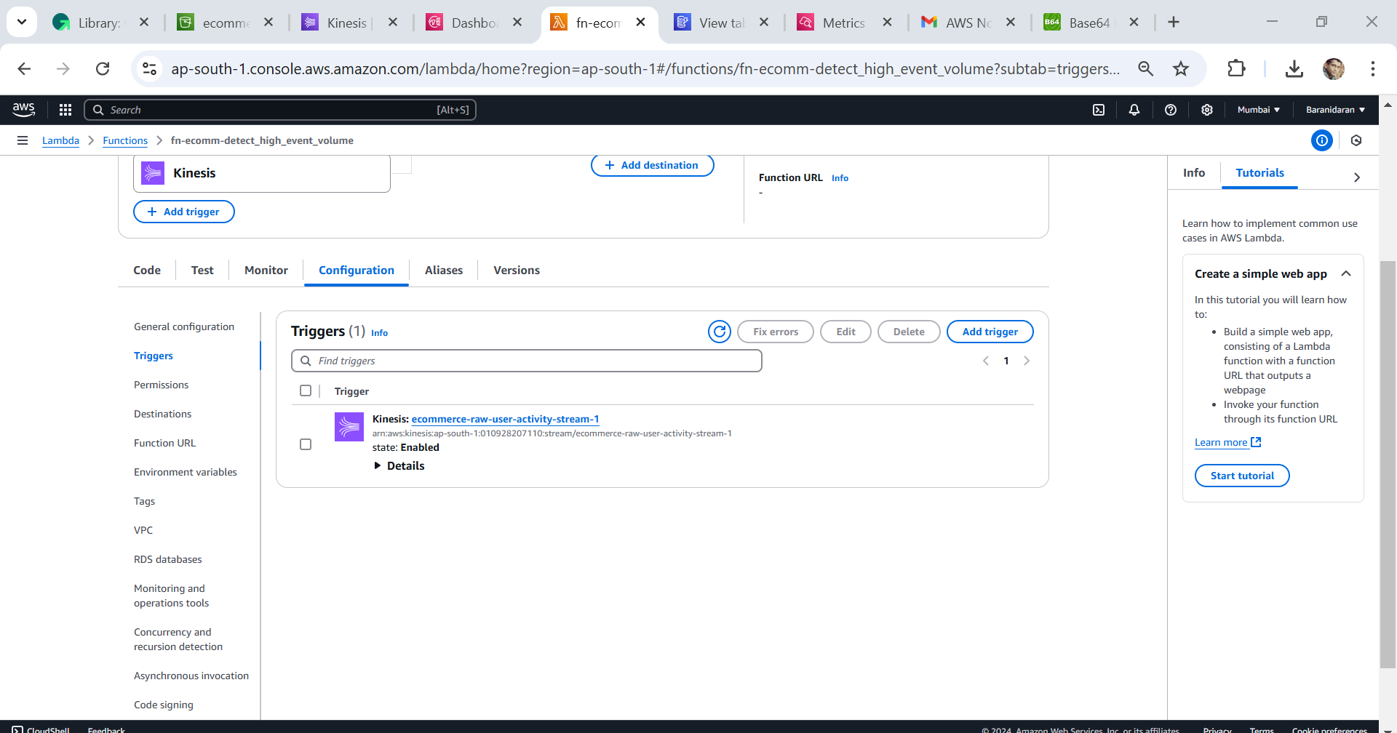
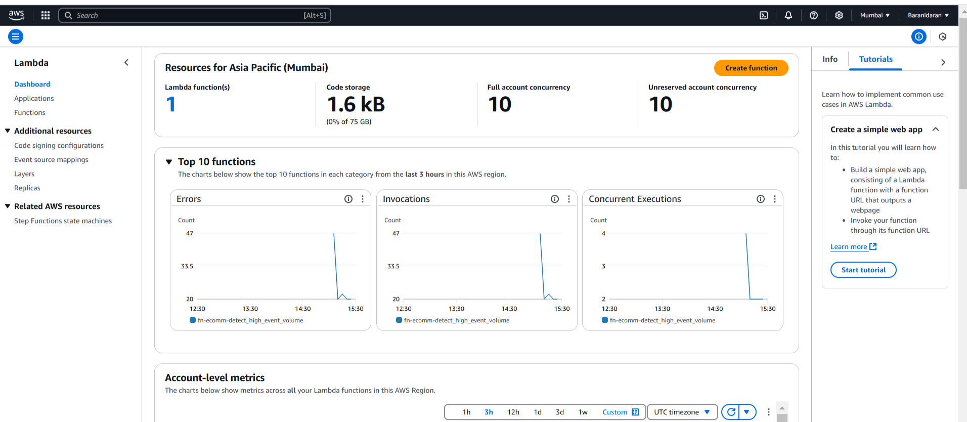
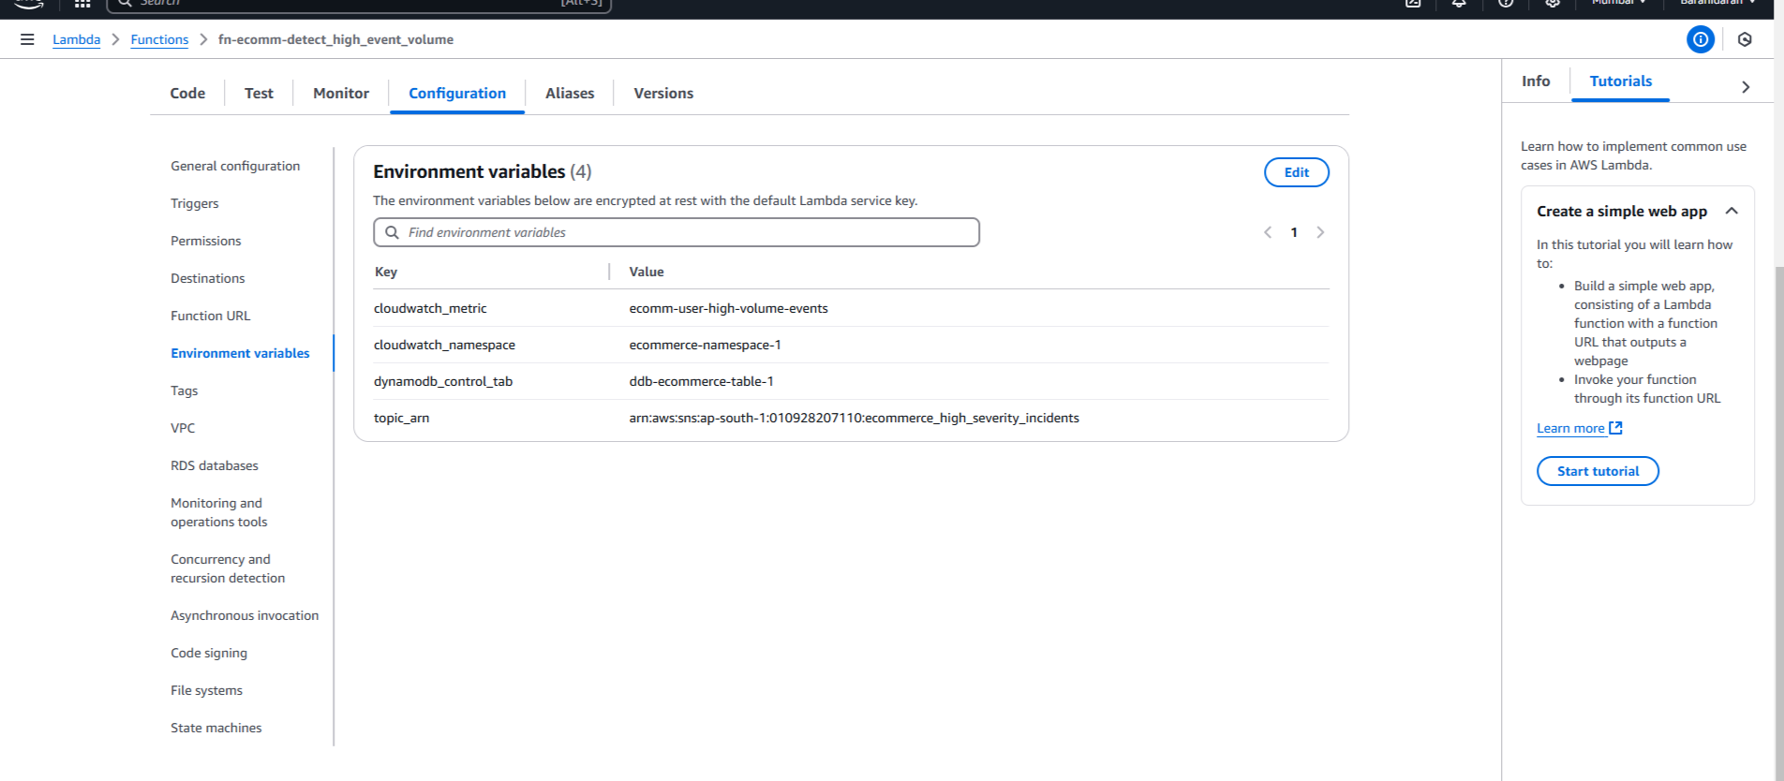
Mini Capstone Project – AWS Services

Slide 9
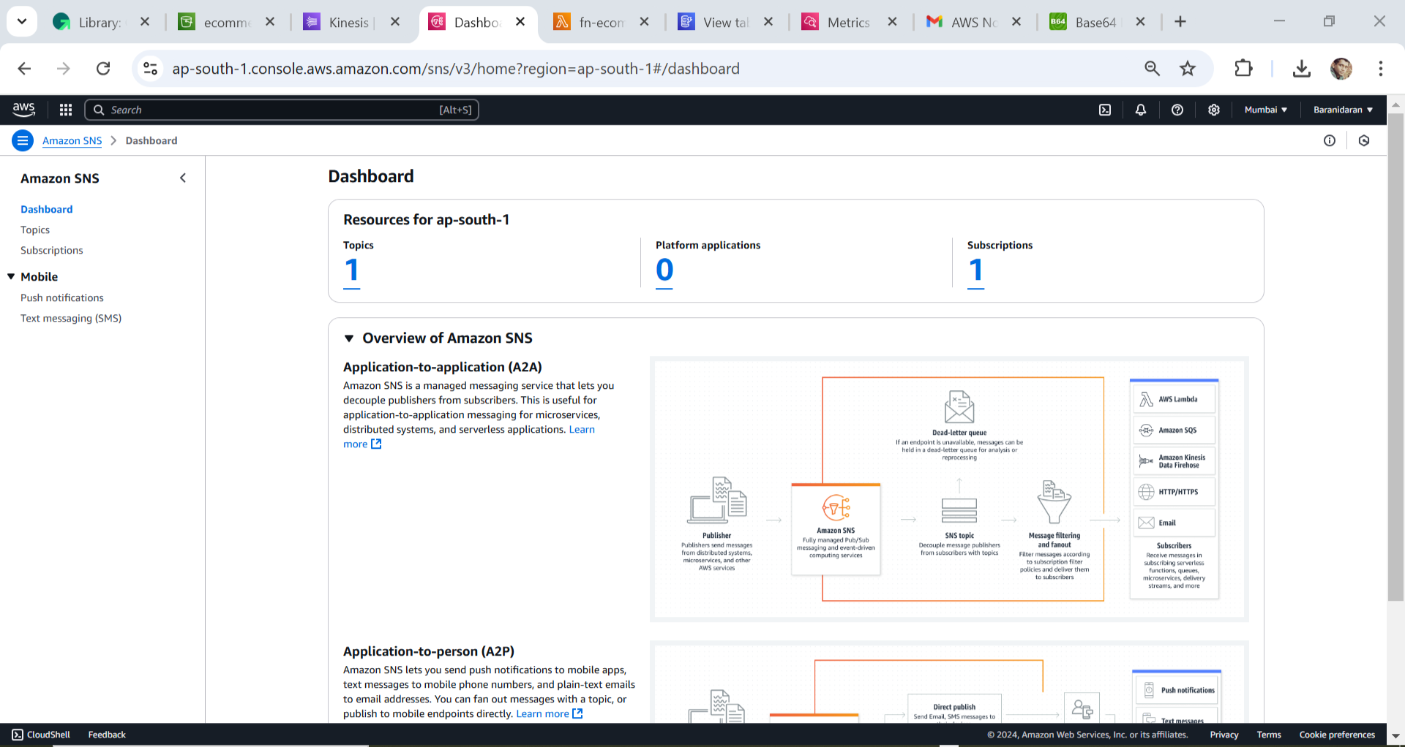
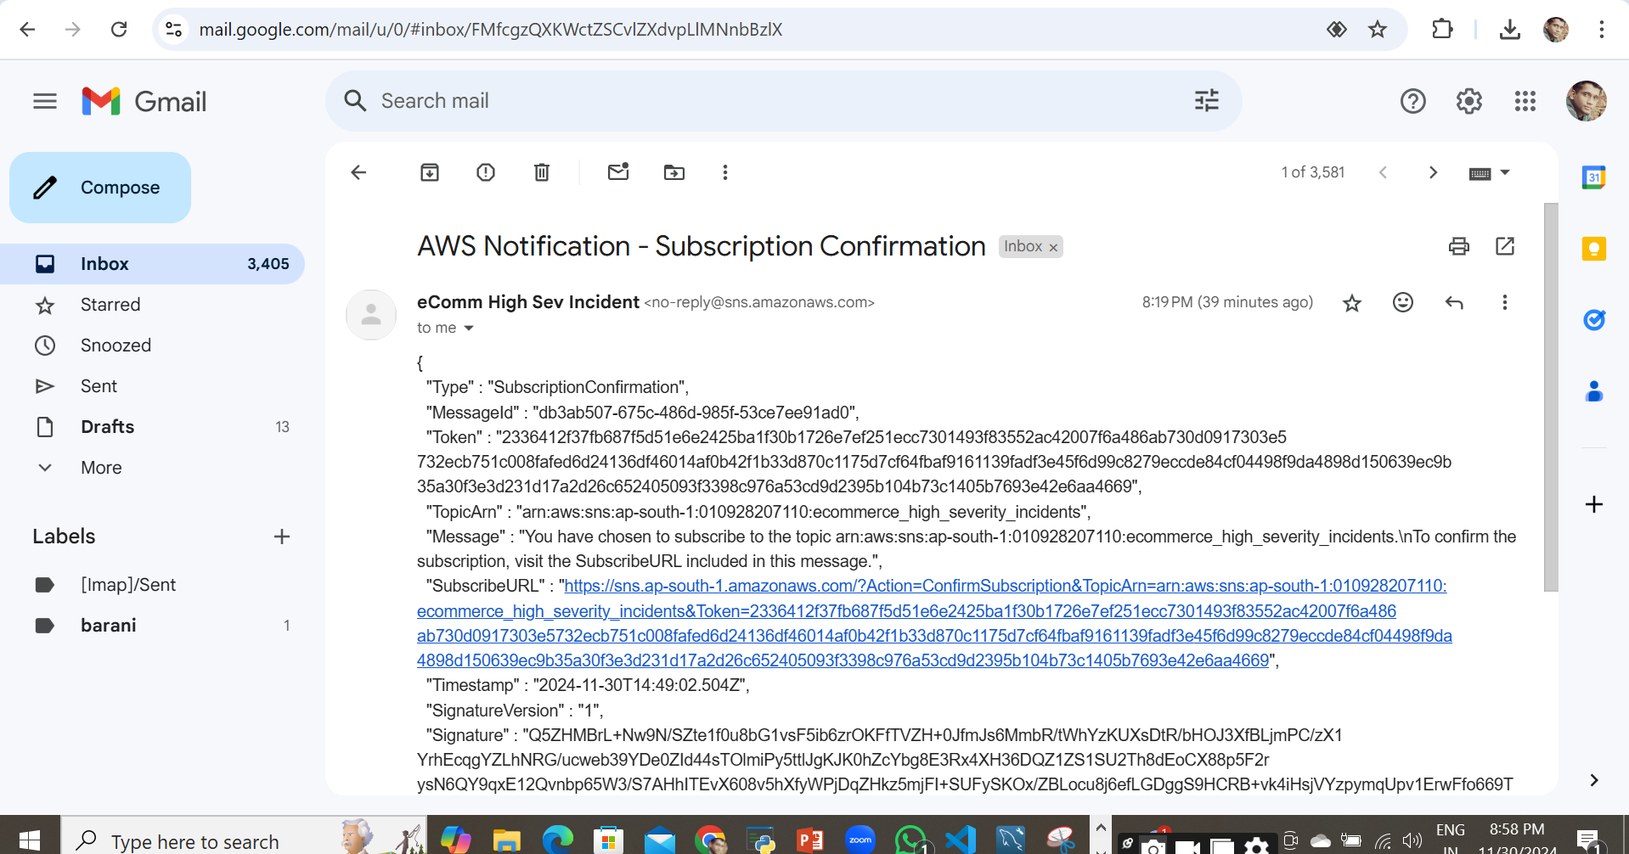
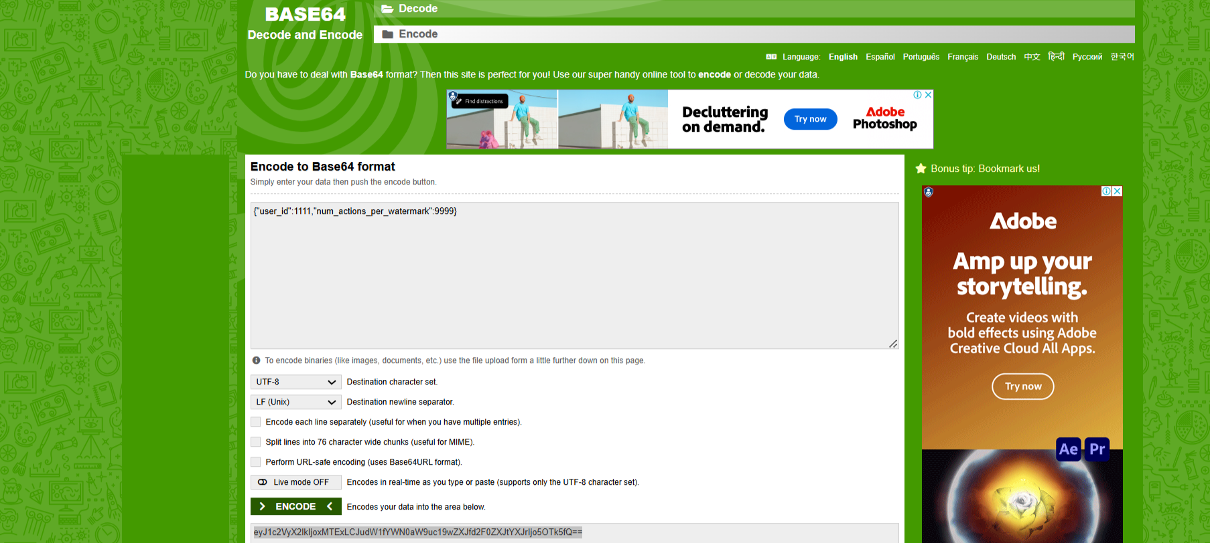
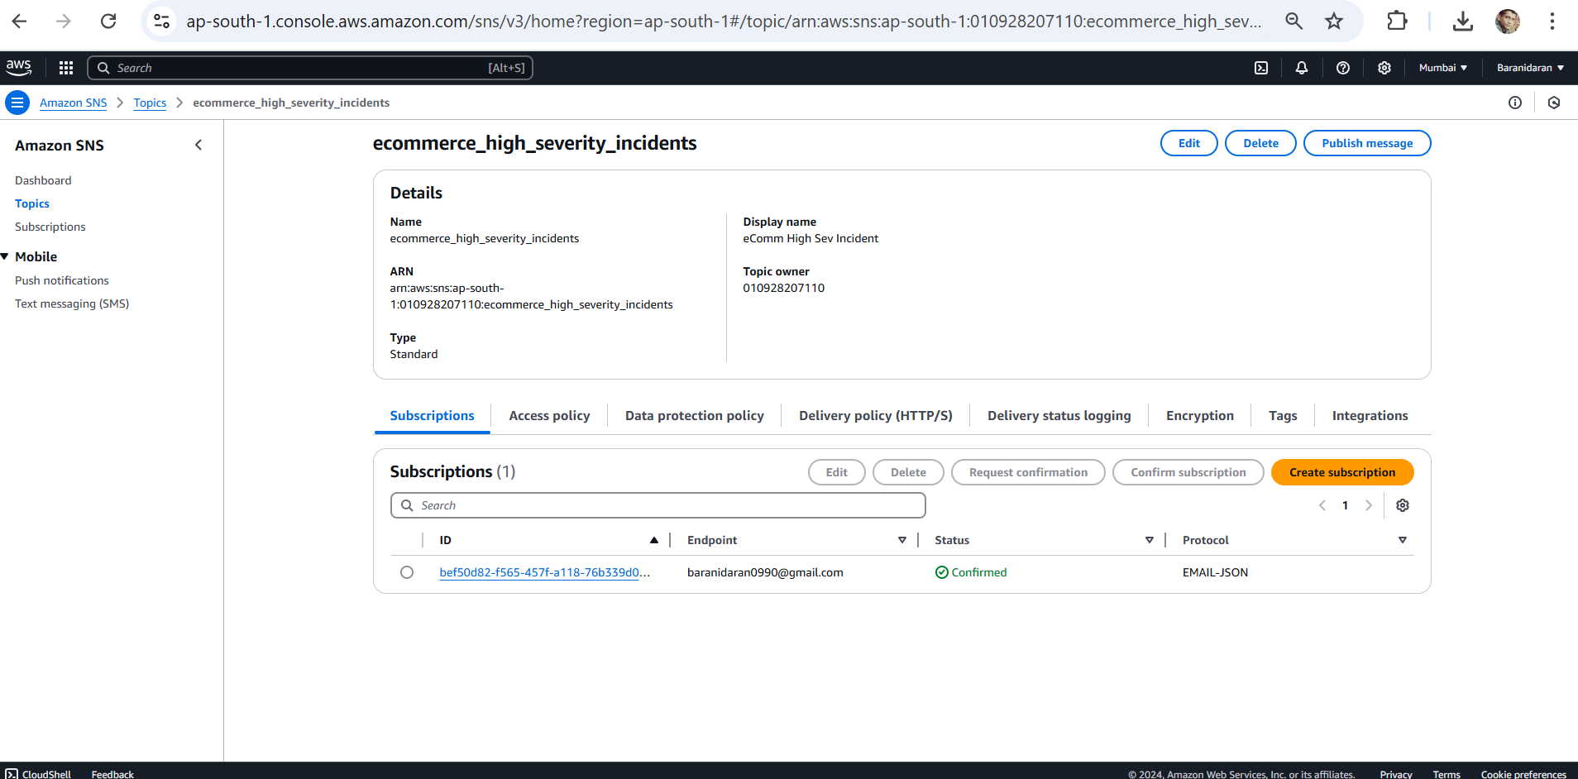
Mini Capstone Project – AWS Services
AWS SNS

Slide 10
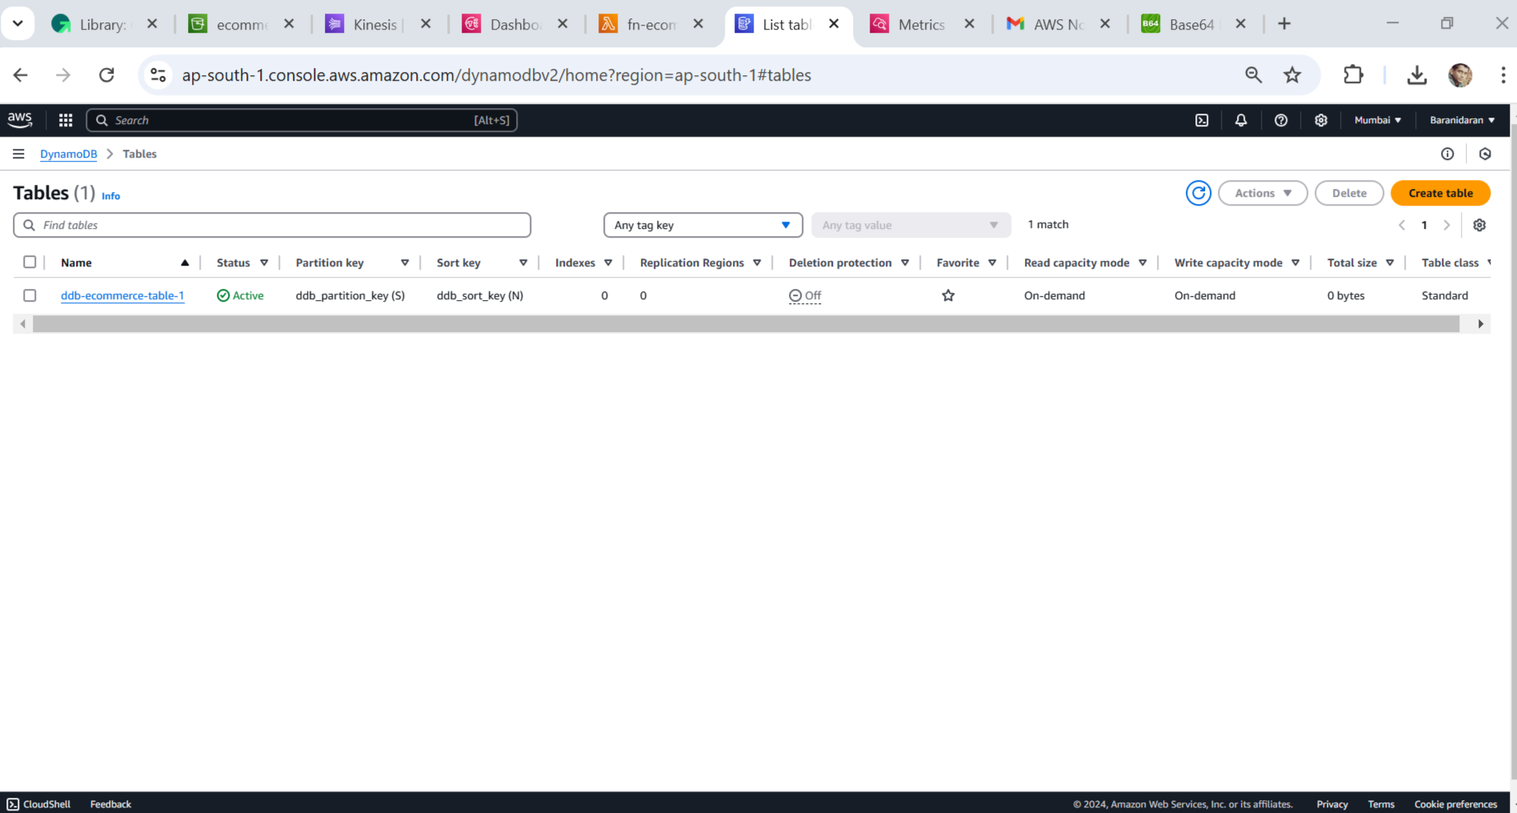
Mini Capstone Project – AWS Services
AWS Dynomodb

Slide 11
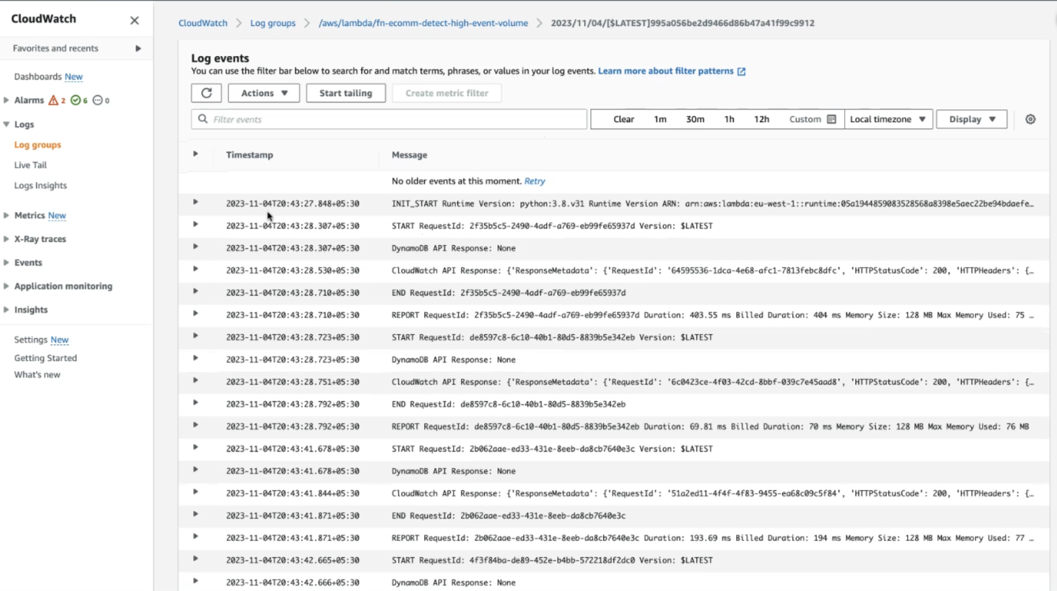
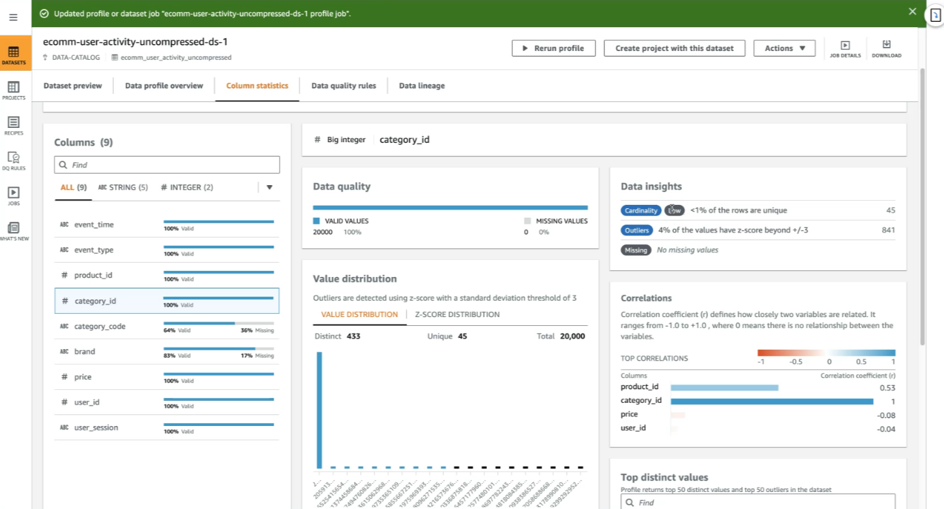
Mini Capstone Project – AWS Services
AWS Cloud Watch

Slide 12
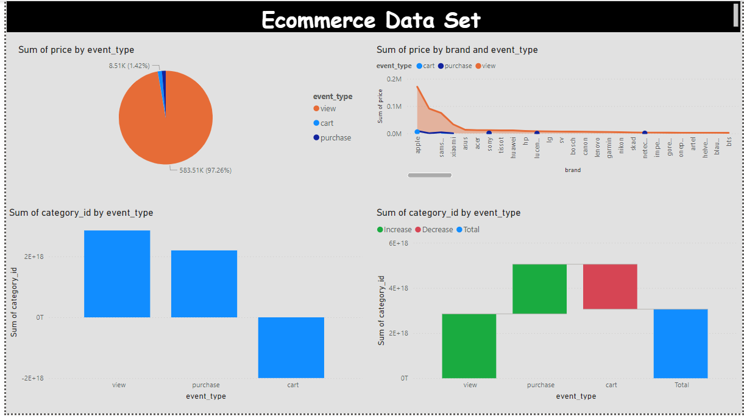
Mini Capstone Project – AWS Services
Power BI dashboard

